Slide 1
Social Internship Presentation
Organisation: Integrated Child Development services(ICDS)
Date:06/07/2024
Institution:Manikam Ramaswami College of Arts and Science

Slide 2
Introduction to ourselfs
M.Hari Pranav
From II DSA
M.Hari Prasath
From II AI
V.Shantha Prabhu
From II AI

Slide 3

Introduction
Observered childrens growth rate
Addressing issues in Anganwaadi
Social internship can add value to your resume andd look you brighter

Slide 4

Main goal of Social Internship
Acadmeic Learning
Carrier development
Learning Experience

Slide 5

Social Internships
About Organisation
Integrated Child Development Services. Integrated Child Development Services Scheme is the centre place to improve the Nutritional status of beneficiary by adapting lie cycle approach intervening sustainable growth strengthen with continuum of care and focus on critical periods of nutritional vulerability.

Slide 6
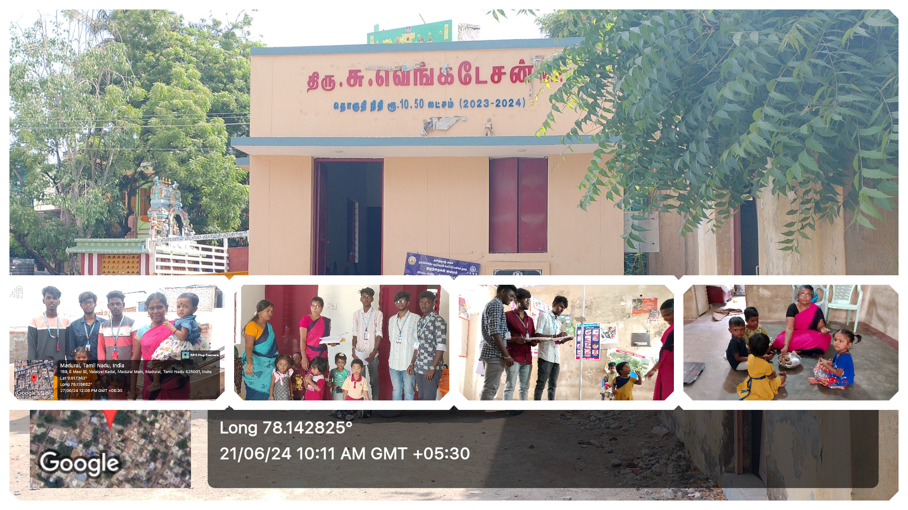
Clips

Slide 7
Skills developed in a Social Internship
Leadership
Data Collection
Work Experience
Teamwork

Slide 8
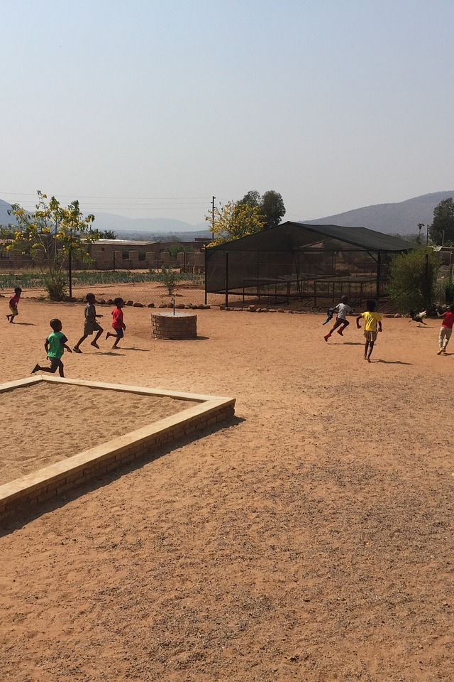
Challenges of a Social Internship
Managing limited resources
Dealing with Angawaadi Center Head
Emotional fatigue

Slide 9

Conclusion
Continuing to make a difference
Reflecting on the social internship experience
Future career opportunities

Slide 10
THANK YOU
The Future Depends on What we Do In The Present

